Slide 1
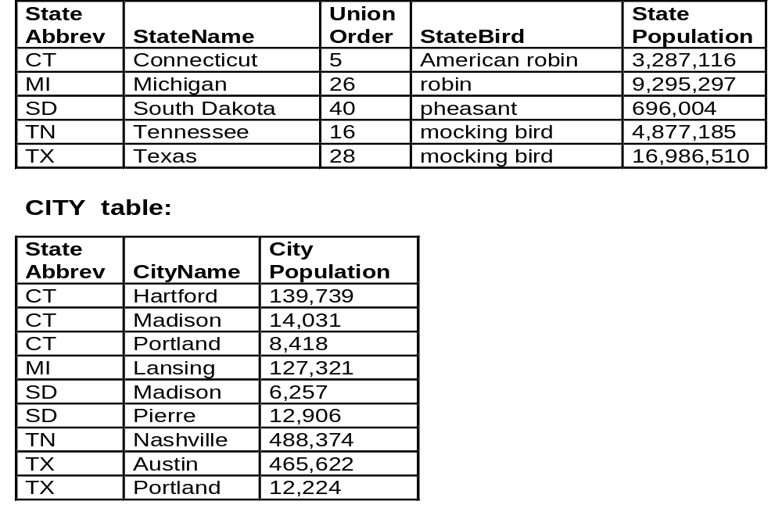
Functional Dependency
attribute B is functionally dependent on attribute A if given a value of attribute A, there is only one possible corresponding value of attribute B
that is, any two rows with the same value of A must have the same value for B
attribute A is the determinant of attribute B if attribute B is functionally dependent on attribute A
in the STATE relation, StateAbbrev is a determinant of all other attributes
in the STATE relation, the attribute StateName is also a determinant of all other attributes
so, StateAbbrev and StateName are both candidate keys for STATE
in the CITY relation above, the attributes (StateAbbrev, CityName) together are a determinant of the attribute CityPopulation
in the CITY relation, the attribute CityName is not a determinant of the attribute CityPopulation because multiple cities in the table may have the same name
  STATE table:
primary key in STATE relation: StateAbbrev
primary key in CITY relation: (StateAbbrev, CityName)
foreign key in CITY relation: StateAbbrev

Slide 2
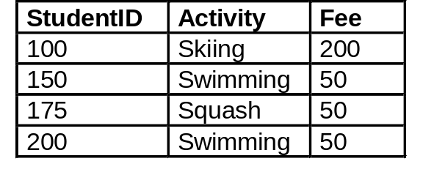
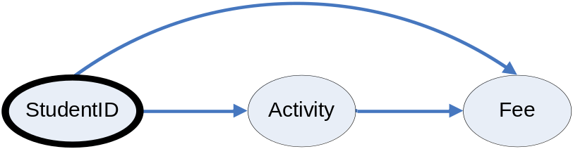
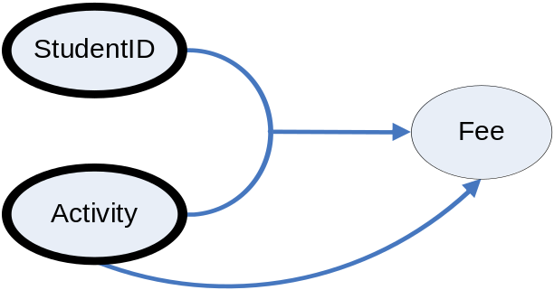
Dependency Diagrams
a dependency diagram or bubble diagram is a pictorial representation of functional dependencies
  an attribute is represented by an oval
  you draw an arrow from A to B when attribute A is a determinant of attribute B
example: in the table above, if students were only allowed one sports activity, we have ACTIVITY(StudentID, Activity, Fee)
example: when students can have multiple activities, we have ACTIVITY(StudentID, Activity, Fee)

Slide 3
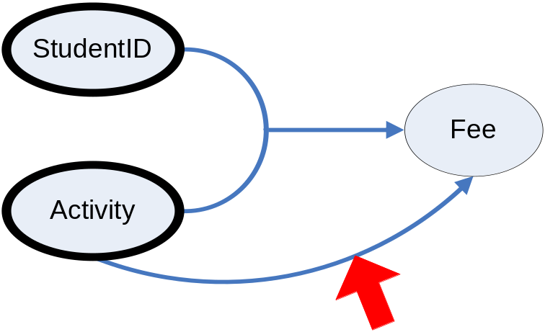
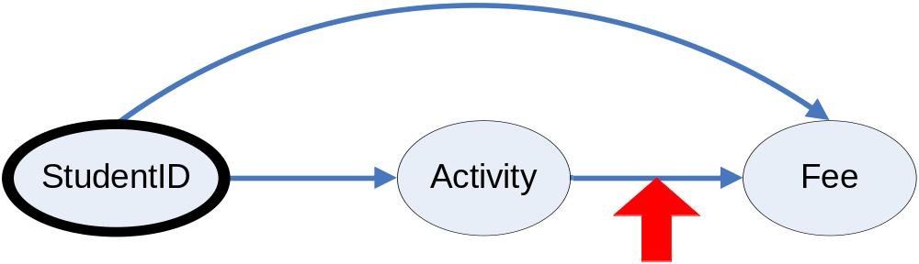
Partial Dependencies
a partial dependency is a functional dependency whose determinant is part of the primary key (but not all of it)
example: ACTIVITY(StudentID, Activity, Fee)
Transitive Dependencies
a transitive dependency is a functional dependency whose determinant is not the primary key, part of the primary key, or a candidate key
example: ACTIVITY(StudentID, Activity, Fee)

Slide 4
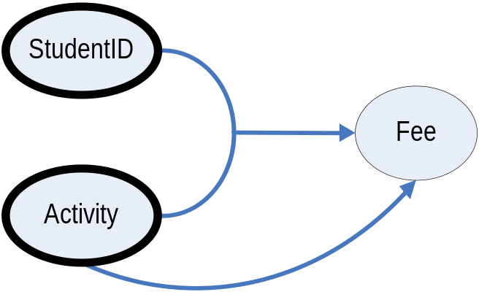
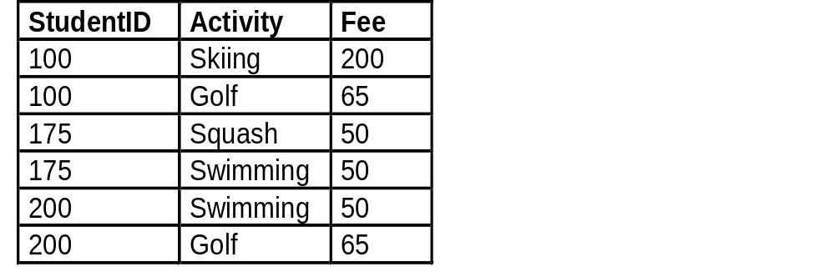
Cause of Anomalies
anomalies are primarily caused by:
  data redundancy: replication of the same field in multiple tables, other than foreign keys
  Functional dependencies whose determinants are not candidate keys, including
    partial dependency
    transitive dependency
example: ACTIVITY(StudentID, Activity, Fee)
Activity by itself is not a candidate key, so we get anomalies (in this case, from a partial dependency):
  insertion anomaly example: we want to store that scuba diving costs $175, but have no place to put this information until a student signs up for scuba diving (unless we create a fake student)
  a deletion anomaly example: if the student with StudentID = 100 takes the semester off and we delete his/her records, we forget that skiing costs $200
  an update anomaly example: if the cost of swimming changes, then all entries with the swimming activity must be changed as well

Slide 5
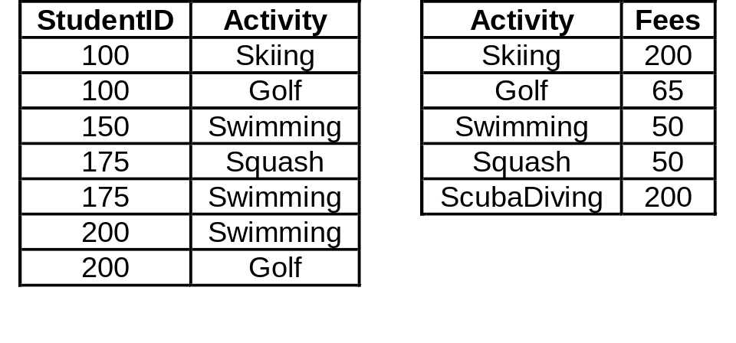
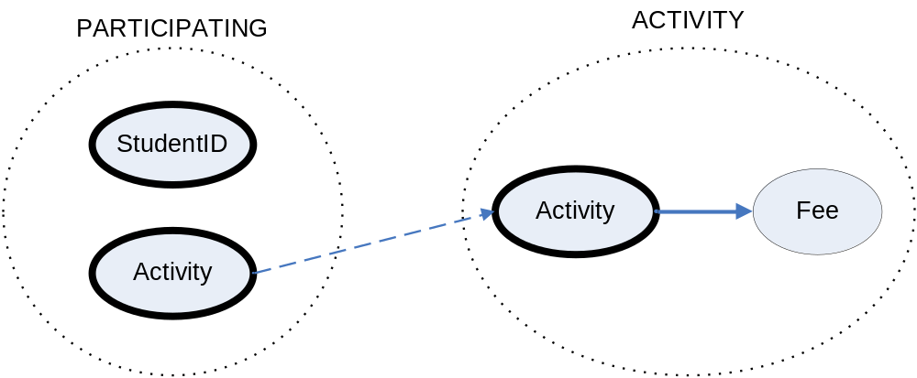
Fixing Anomalies (Normalizing)
Break up tables so all dependencies are from primary (or candidate) keys
  PARTICIPATING(StudentID, Activity)
    Activity foreign key to ACTIVITIES
  ACTIVITY(Activity, Fee)
the above relations do not have any of the anomalies
  we can add the cost of diving in ACTIVITIES even though no one has taken it in STUDENTS
  if StudentID 100 drops Skiing, no skiing-related data will be lost
  if the cost of swimming changes, that cost need only be changed in one place only (the ACTIVITIES table)
the Activity field is in both tables, but that’s needed to relate (“join”) the information in the two tables

Slide 6
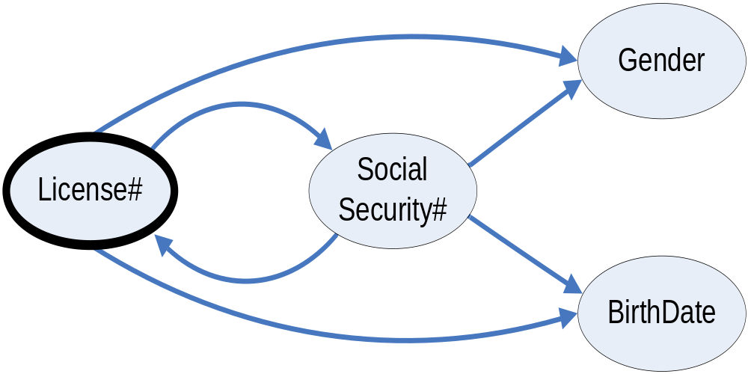
Example With Multiple Candidate Keys
DRIVER(License#, SocialSecurity#, Gender, BirthDate)
The dependencies SocialSecurity# → Gender and SocialSecurity# → BirthDate are not considered transitive because SocialSecurity# is a candidate key, that is, it could be chosen as the primary key for the table.
This kind of design will not give rise to anomalies.

Slide 7
Good Database Design Principles
Recall that two of the DB Design Principles were:
no redundancy: a field is stored in only one table, unless it happens to be a foreign key (replication of foreign keys is permissible, because they allow two tables to be joined together)
no “bad” dependencies: : in a table, fields should depend only and fully on the primary key (or other candidate keys) and not on any other fields.
  in the dependency diagram of any relation in the database, this means that the determinant should be the whole primary key, or a candidate key. Violations of this rule include:
    partial dependencies
    transitive dependencies
    Normalization
normalization is the process of eliminating “bad” dependencies by splitting up tables and linking them with foreign keys
  “normal forms” are categories that classify how completely a table has been normalized
  there are six recognized normal forms (NF):
First Normal Form (1NF)
Second Normal Form (2NF)
Third Normal Form (3NF)
Boyce-Codd Normal Form (BCNF)
Fourth Normal Form (4NF)
Fifth Normal Form (5NF)

Slide 8
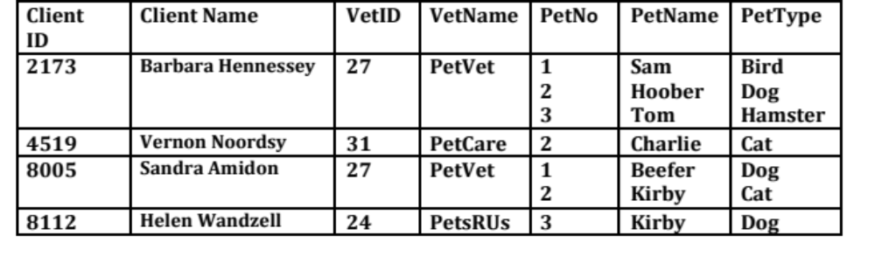
First Normal Form
a table is said to be in the first normal form (1NF)
if all its attributes are atomic. Attributes that are not atomic go by the names
  Nested relations, nested tables, or sub-tables
  Repeating groups or repeating sections
  List-valued attributes
example of a table that is not in first normal form:
CLIENT(ClientD, ClientName, VetID, VetName, PET(PetNo, PetName, PetType) )
This kind of nested or hierarchical form is a very natural way for people to think about or view data.
However, the relational database philosophy claims that it may not be a very good way for computers to store some kinds of data.
Over the years, a lot of information systems have stored data in this kind of format – but they were not relational databases

Slide 9
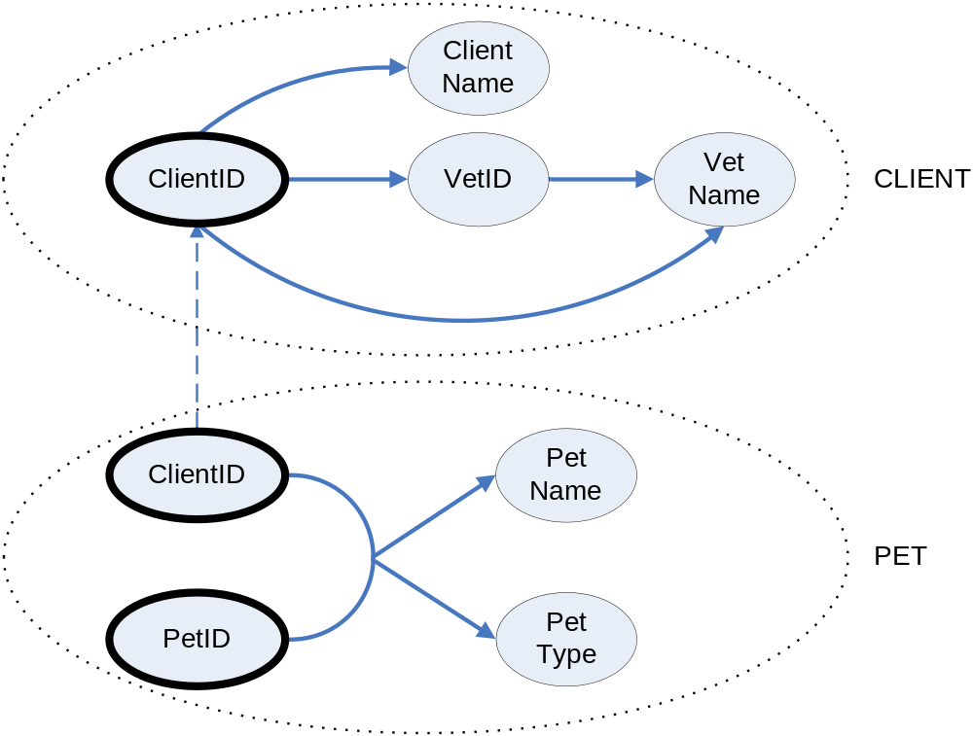
In order to eliminate the nested relation, pull out the nested relation and form a new table
Be sure to include the old key in the new table so that you can connect the tables back together.
PetNo
CLIENT(ClientD, ClientName, VetID, VetName)
PET(ClientID, PetNo, PetName, PetType)
ClientID foreign key to CLIENT
In this particular example, note that PetID is only unique within sets of pets with the same owner.

Slide 10
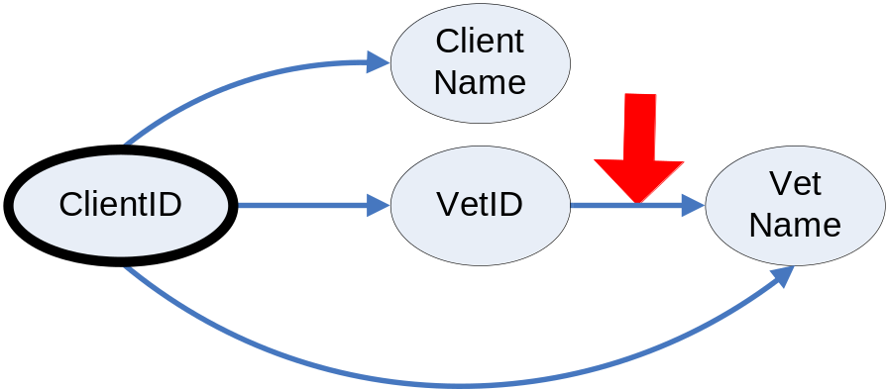
Second Normal Form
Recall: a partial dependency occurs when
  You have a composite primary key
  A non-key attribute depends on part of the primary key, but not all of it
A table in 1NF is said to be in the second normal form (2NF) if it does not contain any partial dependencies.
  Example of a partial dependency:
  ACTIVITY(StudentID, Activity, Fee) on pages 6, 7, and 9
Our new CLIENT-PET database does not have any partial dependencies
So, it already in second normal form
But it still has another functional dependency (transitive):

Slide 11
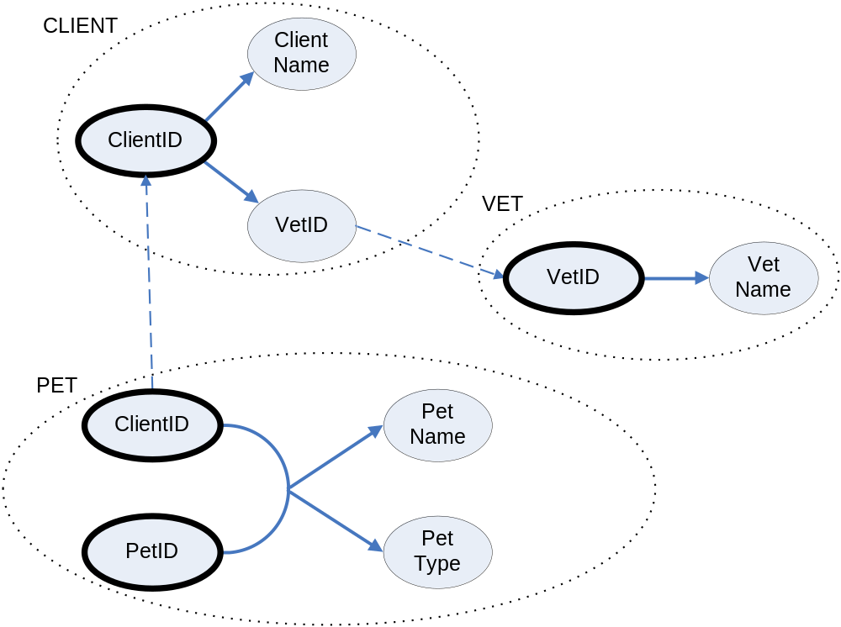
Third Normal Form
Recall: a transitive dependency happens when a non-key attribute depends on another non-key attribute, and that attribute could not have been used as an alternative primary key (or the same thing for a composition of several attributes).
A table of 2NF is said to be in the third normal form (3NF) if it does not contain any transitive dependencies,
In order to eliminate transitive dependency, we split the CLIENTS table again:
    CLIENTS(ClientID, ClientName, VetID)
    VetID foreign key to VET
    PETS(ClientID, PetNo, PetName, PetType)
    ClientID foreign key to CLIENT
    VETS(VetID, VetName)
PetNo

Slide 12
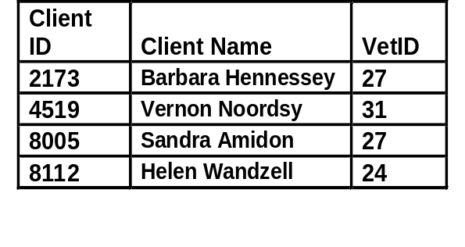
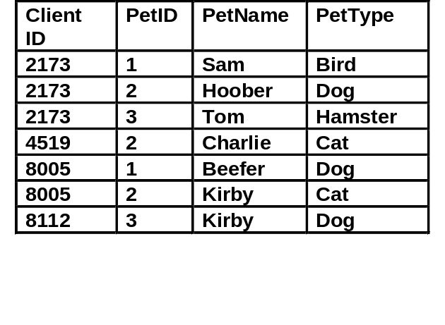
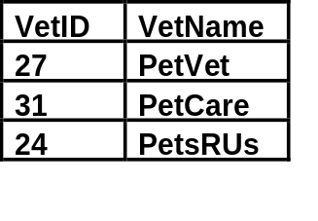
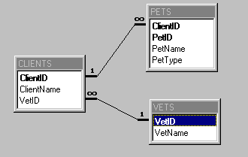
Third Normal Form (Cont.)
CLIENTS-PETS-VETS database in third normal form:
with MS Access table relationships
  the database consists of three types of entities, stored as distinct relations in separate tables:
    clients (CLIENTS)
    pets ( PETS)
    vets (VETS)
  there is no redundancy (only foreign keys are replicated)
  there are no partial and transitive dependencies

Slide 13
Normal Forms and Normalization
Database theorists define some additional normal forms: Boyce-Codd normal form (BCNF, a sort of 3.5th normal form), fourth normal form (4NF), and fifth normal form (5NF).
The distinctions between third normal form (3NF), Boyce-Codd normal form (BCNF), fourth normal form (4NF), and fifth normal form (5NF) are subtle.
They have to do with overlapping sets of attributes that could be used as primary keys (composite candidate keys).
For our purposes, it’s enough to know about 3NF.
  You need to be able to put a database in 3NF.
  You should be able to recognize when a database is in 3NF
  It is also good to be able to recognize 1NF and 2NF, but not as important
Key factors to recognize 3NF:
  All attributes atomic – gives you 1NF.
  Every determinant in every attribute relationship within each table is the whole primary key, or could have been chosen as an alternative primary key – guarantees no partial or transitive dependencies.

